Slide 1
Z534: Search Yelp Dataset Challenge
Sanjana Agarwal
Supreeth Suryaprakash
Raghuveer Krishnamurthy
Suhas Jagadish

Slide 2
Task 1: Predict the label of each business using user “Review” and “Tip” information.
Data preprocessing:
Converted the json files to csv and extracted only the relevant information. For example, extracted ‘review text’ and ‘business_id’ from reviews, ‘business_id’ and ‘category’ from business.
Compared the business and review files to extract just the ‘Review/tip Text’ and ‘Category’.
Category field is a list of keyword, i.e., ['Fast Food', 'Restaurants'] or ['Gluten-Free', 'Asian Fusion', 'Chinese', 'Restaurants']

Slide 3
We made a list of possible categories and a map of keywords to categories, so that we would get a defined category for each business.
For example, the list ['Gluten-Free', 'Asian Fusion', 'Chinese', 'Restaurants'] would be mapped to ‘Chinese’ category or ['Burgers', 'Fast Food', 'Restaurants'] would be mapped to ‘American’.
Once the final file is generated, we use that to train our model. We employ a supervised learning approach using KNN and Multiclass SVM.
We use the Bag of Words model, coupled with TF-IDF vectorization to generate the model file.

Slide 4
Bag of Words and TF-IDF:
Rather than using the existing libraries to create the bag of words and calculate the TF-IDF, we decided to do these tasks from scratch.
We split each review, tokenized it, removed the stop words and created a bag of words, that has been used as our features.
The model file can be thought of as a 2D matrix where x-axis represents each review, y-axis represents the features (bag of words) and the value is the TF-IDF value of the word.
The formula used to compute the TF-IDF is:
tf-idf(d, t)=tf(t)*idf(d, t)
where tf(t) = c(t, doc)/length(doc) and idf(d, t) = log(1+ N/k(t))
Once the TF-IDF values are generated, we create the model file and pass it on to KNN and Multiclass SVM algorithms.

Slide 5
Evaluation:
We divide our dataset in the ratio 70-30 where 70% of the data is used to train the model and 30% to test it.
We use 5-fold cross validation to evaluate the results on the test set.
We determine precision, recall and F1-score for each class label and finally compute the accuracy of our model.
Results:
With KNN, we achieved an accuracy of 82.84%
We experimented with different values of k={2, 4, 6, 8,10} and we found the highest accuracy rating with k=4. (where k is the number of neighbors)
With Multiclass SVM, we achieved an accuracy of 76.92%

Slide 6
Evaluation metrics:
Algorithm | Precision | Recall | Accuracy
KNN | 0.82 | 0.83 | 82.84%
Multiclass SVM | 0.59 | 0.77 | 76.92%

Slide 7
Task 2: Personalization of User’s Dashboard.
What are we doing?
Suggesting similar Users to follow.
Finding the most liked category of a User.
Finding the User’s favorite neighborhood.
Predicting User’s favorite Category.
Suggest top rated businesses in his preferred category and neighborhood.
Predicting possible restaurants he might go to.
Data Preprocessing:
Converted User reviews to Binary Values.
Removed Noise in training data.
Decoded Unicode values for strings. For e.g. Montréal

Slide 8
Find Similar Users to Follow
Spearman Ranking correlation.
We pick top 25 followers with highest correlation.
Predict User’s Favorite Category
Z-Score Normalization
Normalize each rating and finding out which category the User has liked the most.
Predict User’s Favorite Neighborhood
By finding out the User’s check-ins across the Country and taking the cluster with maximum data points as his favorite neighborhood.

Slide 9
Suggest Businesses
Making use of the above two results, We’ll suggest top businesses that he/she can visit.
Take top rated businesses based on User ratings/reviews.
Things taken into consideration,
Most preferred Neighborhood.
Most preferred Category.

Slide 10

Predict Businesses with HMM
Building a HMM where the observed states are the categories and the reviews are the hidden variables
Calculate the ⍺_{t}(x_{t}) using p(y_{t}|x_{t}) i.e, emission probability, p(x_{t}|x_{t-1}) i.e, transition probability and ⍺_{t-1}(x_{t-1}), the message propagated from previous state.
The resulting ⍺_{t} is the probability of a certain category having a good / bad review based on User history.

Slide 11
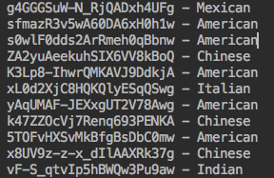
Sample Output:
Similar Users:
Favorite Category:

Slide 12
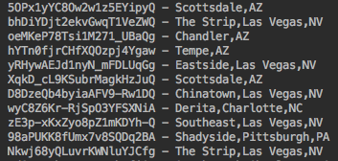
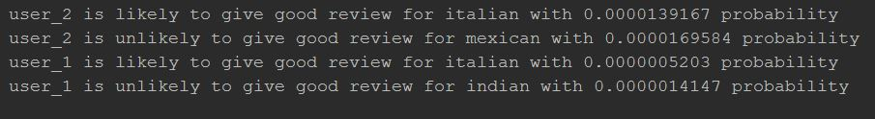
Most Preferred Neighborhood:
Business Prediction with HMM:

Slide 13
Evaluation Metrics:
We use Normalized Discounted Cumulative Gain (NDCG) to evaluate the accuracy of our Prediction model.
For Each User we have a ranking vector which has top rankings for Followers, Neighborhood and Categories.
Using MAE to calculate the Error of our Prediction model.

Slide 14
Teams:
Task 1:
Data Processing – Suhas
Approach(BOW, TF-IDF, KNN, SVM) – Suhas and Sanjana
Evaluation – Suhas and Sanjana
Task 2:
Data processing – Supreeth and Raghuveer
Approach (HMM) – Raghuveer
Approach (Most liked Category, Neighborhood, potential followers, suggesting Restaurants) – Supreeth
Evaluation – Supreeth and Raghuveer

